Slide 1

TEAM - 11
Minesweeper
using
Jack Language
Team members : 1.Shyam Ganesh (21149) 2.Sidesh Sundar (21150) 3.Sabarinath (21141) 4.Jayakrishna (21154) 5.Sai Teja (21124) 6.Bharadwaj (21165)

Slide 2

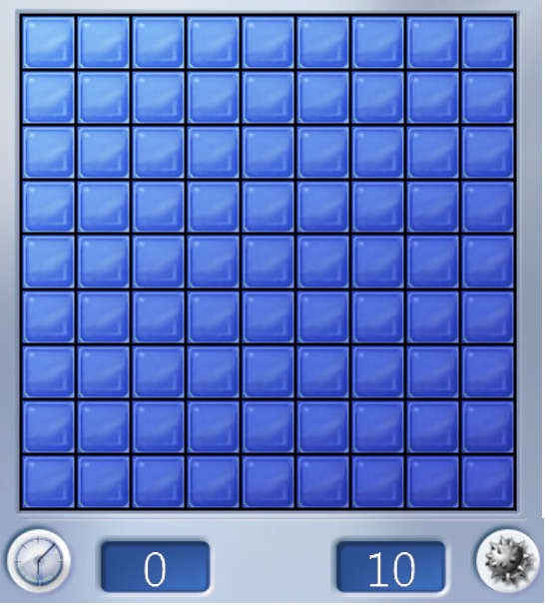

INTRODUCTION :
Minesweeper is a game where mines are hidden in a grid of squares. Safe squares have numbers telling you how many mines touch the square. You can use the number clues to solve the game by opening all of the safe squares. If you click on a mine you lose the game!

Slide 3

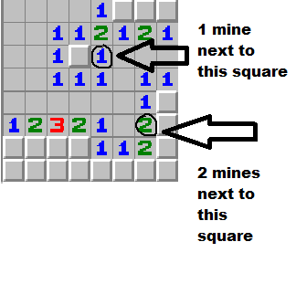
HOW TO PLAY :
To play Minesweeper, players have to press a square first. But it is more than just guessing which square to click. Observation and deduction is the name of the game.
Take note that the number around the boxes is the clue to know where the mines are.
There are ones and twos, and it will tell you how many bombs are touching the square. If the box is near number one which means that one of the squares around it has the "mine“. Likewise, the number two indicates that there is more than one explosive adjacent to it.
It turns out that these numbers guide players throughout the game. The final goal is to clear the map and refrain from blowing the bomb.

Slide 4

JACK FILES WE HAVE IN THIS PROJECT :
Cursor: In this class we created the cursor by giving it a position in X and Y axis so that we can move the cursor along the grids.
Main: In this class we have uncommmented and recompiled the files to run the tests. This initializes the game string and generates random numbers. It checks whether QueueTest and RandomTest works properly or not and gives the output if it runs properly.

Slide 5

Maths: In this class we gets the value of X and Y and return the value of X-(Y-(X/Y)). We also convert character to integer.
Minesweeper: In this class we constructed the minesweeper game. The first step is to set the grids and place the mines. The base game variables values are grid-width=24, grid- height=12, grid-percentmines=12.

Slide 6

Grid: In this class we created the grid by giving the values for column width, row height, flag count ,mine probability, mine count.
Node: In this class we have created a doubly linked list which has 3 values: 1] value 2] Prev 3] Next

Slide 7

QUEUE : It is a simple FIFO queue implemented as a doubly-linked list so the values stored can only be integers.
QUEUE TEST : In this class we are going to add values to the queue which we created before.
Random : In this class Random we have to use the keyboard presses as noise to seed the random number generator.
Random Test : In this class we have created a function named test.

Slide 8

SPRITES : In this class we drew the border of the grid using drawborder function . Also we have created the bitmap code for Cursor, Closed cell, Mine, Flag, Numbered cell, Zero cell, One cell, Two cell, Three cell, Four cell, Five cell, Six cell, Seven cell, and Eight cell.
STRINGS : We used static variables and initialized them so that they don’t take up heap space while reconstucting the string multiple times.
TUTORIAL : This is displays the information of the game and rules and how to play the game.
On pressing enter button the text message will vanish and the game will start.
UTILS : This class takes the combination of x, y cell coordinates and converts it into a memory location for the 16x16 draw function.
It returns 1 if the given cell value is a mine otherwisse 0.

Slide 9

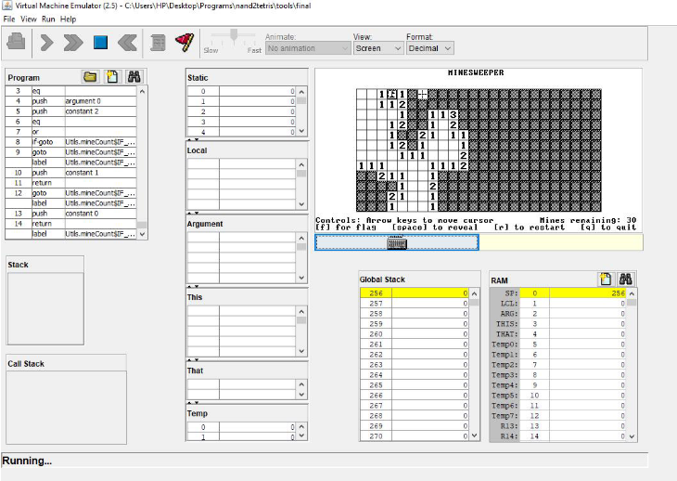
OUTPUT :
PLAYING :

Slide 10

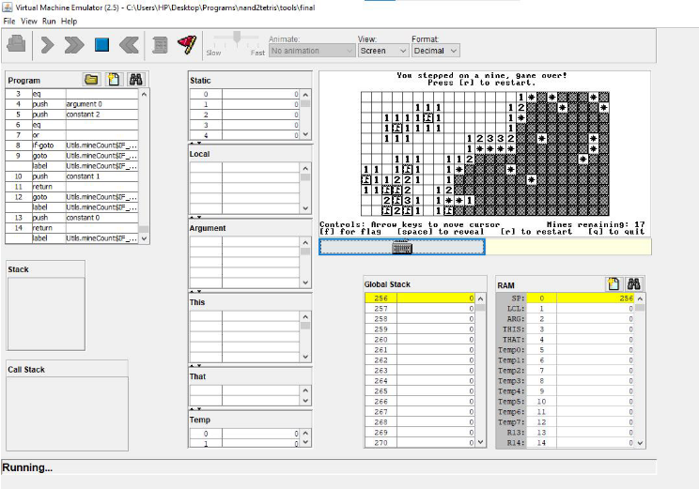
GAME LOST :

Slide 11
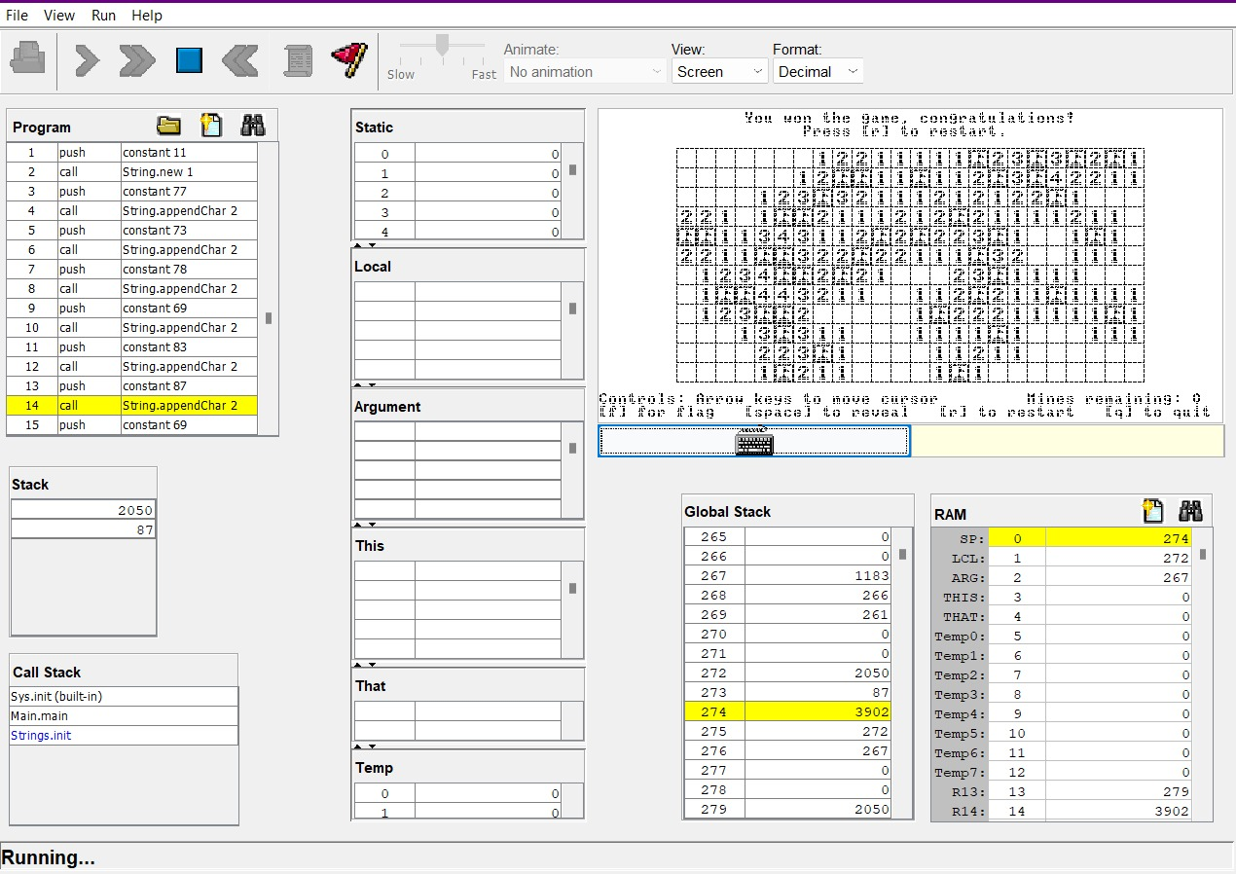
GAME WON :

Slide 12

CONCLUSION : This is my final project for the nand2tetris course. It’s a Minesweeper game written in the Jack language.The course challenges us to build a full application (in this case, Minesweeper) using a high level language (the Jack language) compiled using a compiler we wrote ourselves, with an operating system we write ourselves, running on a hardware platform (the Hack machine) we designed ourselves, powered by a CPU we wired together ourselves.

Slide 13

FUTURE SCOPE :
We are planning to add few more difficulty level by increasing the number of rows and columns and the number of mines.
Further we planned to add picture which displays after the player wins or loses the game .

Slide 14



